Slide 1

Data Analysis in Qualitative Research

Slide 2
What is data analysis?
A complex process that involves moving back and forth
  between concrete bits of data and abstract concepts
  between inductive and deductive reasoning
  between description and interpretation
Simply put: Data analysis is the process of making meaning from the data

Slide 3
Preliminary Exploratory Analysis
Explore the data by reading through all of your information to obtain a general sense of the information
Memo ideas while thinking about the organization of the data and considering whether more data are needed
  Jot memos in margins of fieldnotes, transcripts, documents, photos

Slide 4
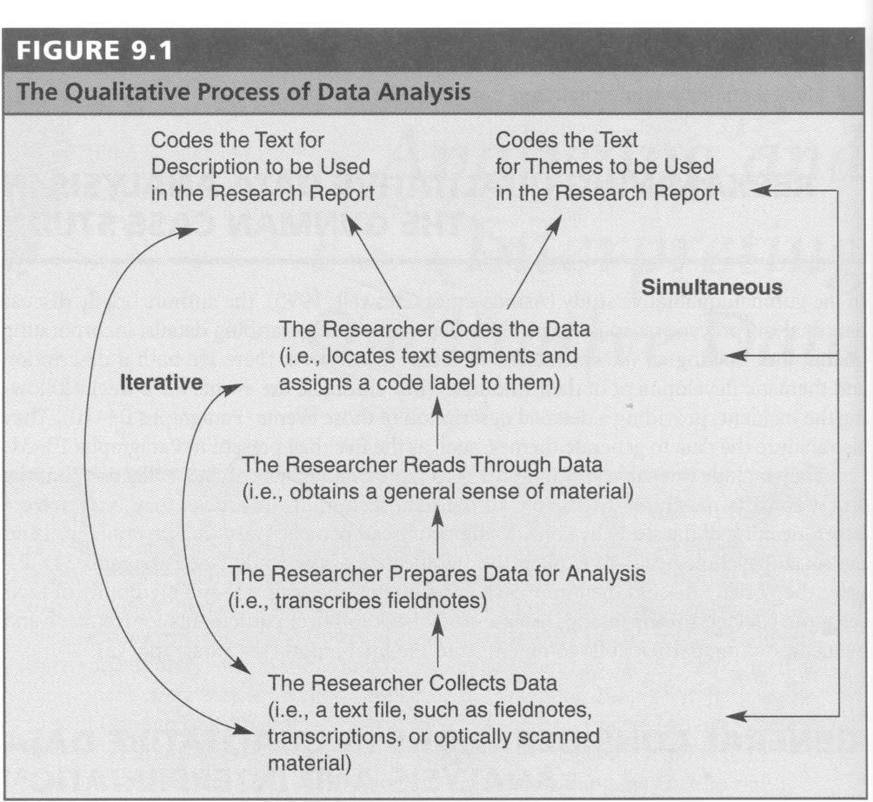

Slide 5

Developing Descriptions & Themes from the Data (case study approach)
Coding data
Developing a description from the data
Defining themes from the data
Connecting and interrelating themes

Slide 6
Coding Data
Open Coding
  Assign a code word or phrase that accurately describes the meaning of the text segment
  Line-by-line coding is done first in theoretical research
  More general coding involving larger segments of text is adequate for practical research (action research)

Slide 7
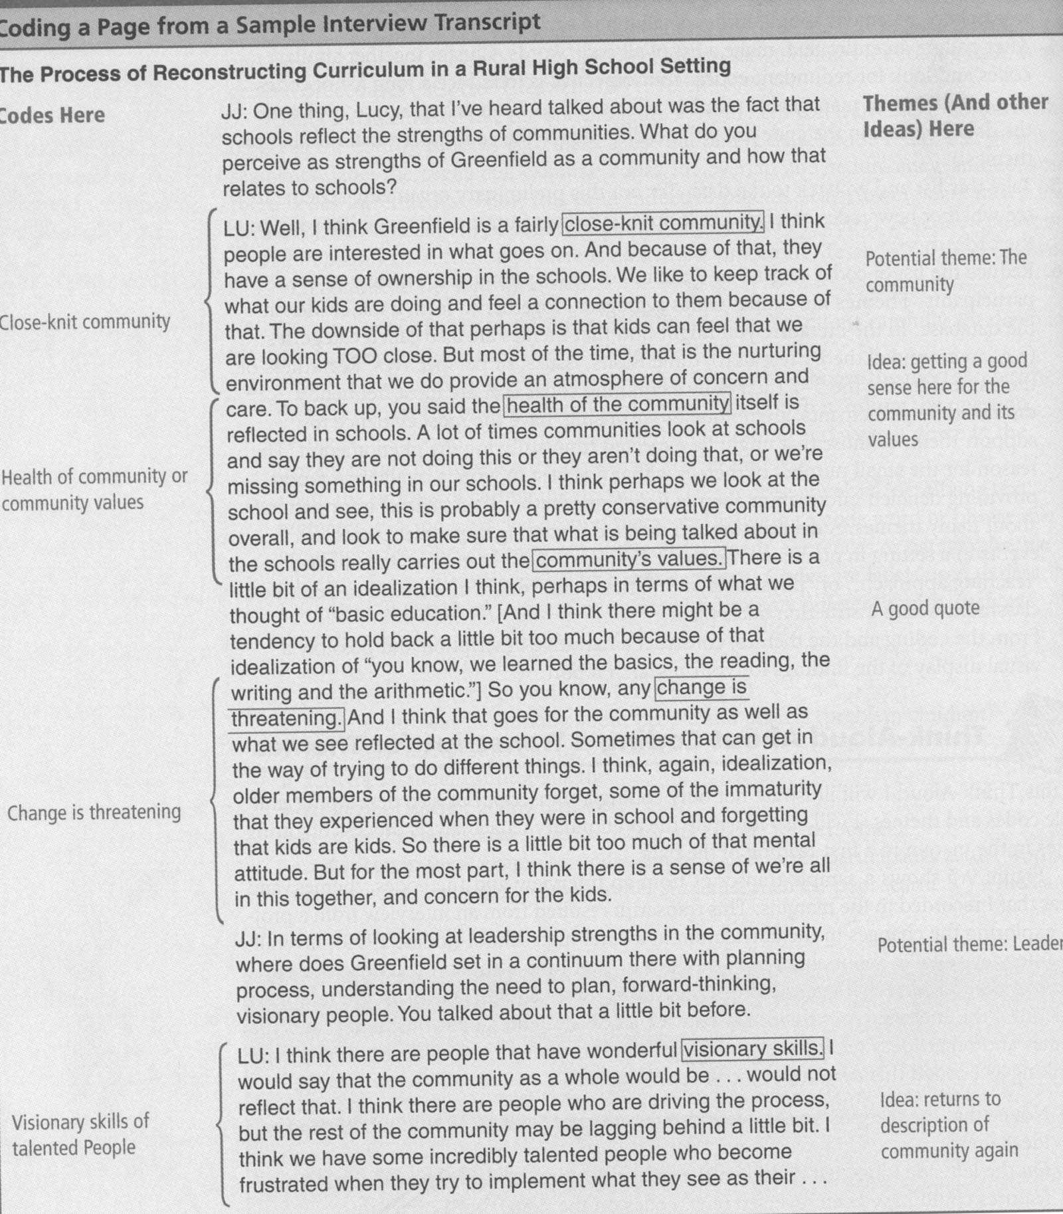

Slide 8
Axial Coding
The process of looking for categories that cut across all data sets
After this type of coding, you have identified your themes
You can’t classify something as a theme unless it cuts across the preponderance of the data

Slide 9
Clustering
After open coding an entire text, make a list of all code words
Cluster together similar codes and look for redundant codes
Objective: reduce the long list of codes to a smaller, more manageable number (25 or 30)

Slide 10
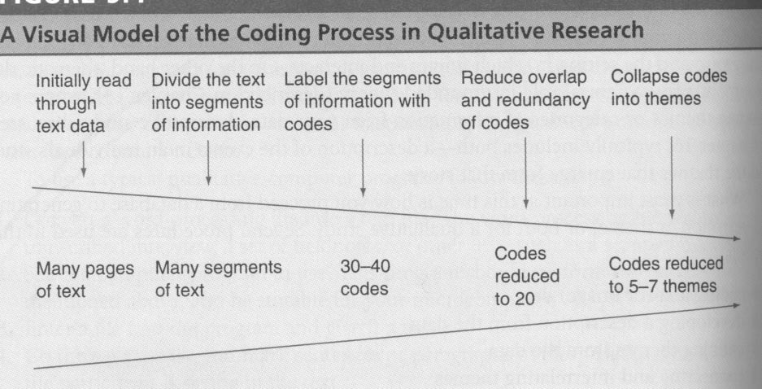

Slide 11
Preliminary organizing scheme
Take this new list of codes and go back to the data
Reduce this list to codes to get 5 to 7 themes or descriptions
Themes are similar codes aggregated together to form a major idea in the database
Identify the 5-7 themes by constantly comparing the data (Constant Comparative Analysis)

Slide 12
Constant Comparative Analysis (Glaser & Strauss; p. 86, The Art of Classroom Inquiry)
A process whereby the data gradually evolve into a core of emerging theory
This core is a theoretical framework that further guides the collection of data
Major modifications are lessened as comparisons of the next incidents of a category to its properties are carried out (Merriam, 1998).

Slide 13
Why themes?
It is best to write a qualitative report providing detailed information about a few themes rather than general information about many themes
Themes can also be referred to as Categories

Slide 14
Naming the Themes or Categories
The names can come from at least three sources:
  The researcher
  The participants
  The literature
Most common: when the researcher comes up with terms, concepts, and categories that reflect what he or she sees in the data

Slide 15
Themes should…
Reflect the purpose of the research
Be exhaustive--you must place all data in a category
Be sensitizing--should be sensitive to what is in the data
  i.e., “leadership” vs. “charismatic leadership”
Be conceptually congruent--the same level of abstraction should characterize all categories at the same level
  For instance, you wouldn’t have produce, canned goods, and fruit

Slide 16
Types of themes
Ordinary: themes a researcher expects
Unexpected: themes that are surprises and not expected to surface
Hard-to-classify: themes that contain ideas that do not easily fit into one theme or that overlap with several themes
Major & minor themes: themes that represent the major ideas, or minor, secondary ideas in a database
  Minor themes fit under major themes in the write up

Slide 17
A Description
A detailed rendering of people, places, or events in a setting in qualitative research
Codes such as “seating arrangements,” “teaching approach,” or “physical layout of the room,” might all be used to describe a classroom where instruction takes place

Slide 18
Narrative description
From the coding and the themes, construct a narrative description and possibly a visual display of the findings for your research report
Use the assigned format (see syllabus)

Slide 19
Constructing the narrative
Identify dialogue that provides support for themes
Look for dialogue in the participants’ own dialect
Use metaphors and analogies
Collect quotes from interview data or observations
Locate multiple perspectives & contrary evidence
Look for vivid detail
Identify tensions and contradictions in individual experiences

Slide 20
Conveying personal reflections
Because qualitative researchers believe that personal views can never be kept separate from interpretations, personal reflections about the meaning of the data are included in the research study
  “David had been diagnosed with AD/HD and also with mild Tourette Syndrome. He took medication for AD/HD. He was selected to participate in the project as a confirming participant because he was so involved with the project and so intense during the first observation. Unaware that he had AD/HD and Tourette Syndrome until I interviewed his mother during the second year of the project, I was surprised because he was the most focused student in the classroom.”(Terry, 2003)

Slide 21
Providing Visual Data Displays
Qualitative researchers often display their findings visually
  Comparison table or matrix
  Hierarchical tree diagram that represents themes and their connections
  Boxes that show connections between themes
  Physical layout of the setting
  Personal or demographic information for each person or site

Slide 22




Effects of Celebration
Enhances Commitment, Attitudes,
and Student Development
Commitment
Attitudes
Empowerment
Student
Development
Methodology

Slide 23
Making comparisons with the Literature
Interpret the data in view of past research
Show how the findings both support and contradict prior studies
  “These findings are consistent with other studies in regard to duration. It has been found that the length or duration of service learning projects has an impact on student outcomes, with the longer duration projects having greater impacts. However, significant differences are not found in projects lasting over 18 weeks (Conrad & Hedin, 1981). The project on which this study focused was examined over a year and a half period of time; thus it is considered to be long in duration which helps to explain its impact on student outcomes.”

Slide 24
Limitations of the study
The researcher suggests possible limitations or weaknesses of the study
  “This study focused on one rural middle school in an area in Northeast Georgia, Hartwell. It documented the methodology used in the service learning project and the effect of a certain type of service learning model, Community Action. Therefore, the study provides an in-depth look at a service learning project carried out by gifted students in just one middle school in a rural area situated in a Southern state. Transferability may be limited as a result” (Terry, 2001).

Slide 25
Future Research Suggested
Researchers make recommendations for future research
  “In addition, further research is needed to determine outcomes for a diversified culture of students, including, but not limited to African-American students and students diagnosed with AD/HD. Research is also needed to examine and validate existing frameworks before professing any general claims concerning the outcomes for students engaged in service learning activities” (Terry, 2003).

Slide 26
Validating the Accuracy of Findings
At the end, the qualitative researcher validates the finding by determining the accuracy or credibility of the findings. Methods include:
  Prolonged engagement & persistent observation in the field
  Triangulation
  Peer Review
  Clarifying researcher bias
  Member Checking
  Rich, thick description
  External Audit

Slide 27
Addressing Research Bias
“I am not an impartial bystander when it comes to service learning so I knew I had to enhance internal validity at the outset of the study. I have been involved with Community Action service learning projects for over 16 years as a teacher. I have co-authored a book on how to facilitate Community Action service learning projects which I have used to implement service learning projects in my own classroom. My students have been featured in Reader’s Digest and have been guests on the Phil Donahue Show because of their outstanding work in service learning. Being aware of this bias, I took extreme precautions to maintain objectivity during both the collection and analysis of the data thereby accurately representing the project fairly and accurately” (Terry, 2001).

Slide 28
Reliability or Dependability
From a quantitative perspective, reliability refers to the extent to which research findings can be replicated
From a qualitative perspective, dependability, (reliability) in qualitative research is not based on outsiders getting the same results, but that outsiders concur that, given the data collected, the results make sense. In other words, the results are dependable and consistent (Lincoln & Guba, 1985).

Slide 29
External Validity
Concerned with the extent to which the findings of one study can be applied to other situations
Quantitative studies enhance external validity using a priori conditions which are limiting in conducting qualitative research
External validity is problematic in qualitative research because “In qualitative research, a single case or small nonrandom sample is selected precisely because the researcher wishes to understand the particular in depth, not to find out what is generally true of the many” (Merriam, 1998, p. 208).

Slide 30
Applying external validity to qualitative research
Think in terms of the reader of the study
What is the extent to which a study’s findings can apply to other situations?
This is referred to as Representativeness or Transferability
Merriam (1998) suggests: rich, thick description and typicality, modal category, or multisite designs
  “To enhance external validity in this study, these procedures were followed:

